Slide 1
Adversarial Thinking Module
Lesson 2: Intro to Game Theory
Notes:
These materials were made possible by a grant from the NSA National Cybersecurity Curriculum Program, Round 1.
All pictures and graphics used in these materials carry a Creative Commons license.
The slides are Section 508 compliant.
These materials were created by:
Seth Hamman, Ph.D.
Director, Center for the Advancement of Cybersecurity
Associate Professor of Computer Science
Cedarville University
Email: shamman@cedarville.edu
Phone: 937-766-7686
Please contact the author with any errata, suggestions for improvement, or to provide any other feedback.

Slide 2
Topics Covered in this Lesson
Game Theory
The Prisoner’s Dilemma Game
Nash Equilibrium
Strictly Dominated Strategies
Notes:
This lesson is intended to be about 45-60 minutes in length, depending on the depth you desire and the amount of time you allocate to the exercises.

Slide 3
Student Learning Outcomes
Upon completion of this lesson, students will be able to:
Analyze a strategic scenario from a game theoretical perspective.
Upon completion of this module, students will be able to:
Analyze cybersecurity from the strategic perspective of cyber adversaries.
Notes:
The Assessment Guide includes several questions that both clarify and assess this learning outcome.
Each of the three lessons in this module has one learning outcome. The learning outcomes build on one another and culminate in the overall module learning outcome.
The learning outcomes for each of the three lessons are:
Lesson 1: Students will be able to illustrate the three components of adversarial thinking for cybersecurity
Lesson 2: Students will be able to analyze a strategic scenario from a game theoretical perspective.
Lesson 3: Students will be able to apply level-k reasoning to derive playing strategies in strategic contests.
The module learning outcome is:
Students will be able to analyze cybersecurity from the strategic perspective of cyber adversaries.

Slide 4
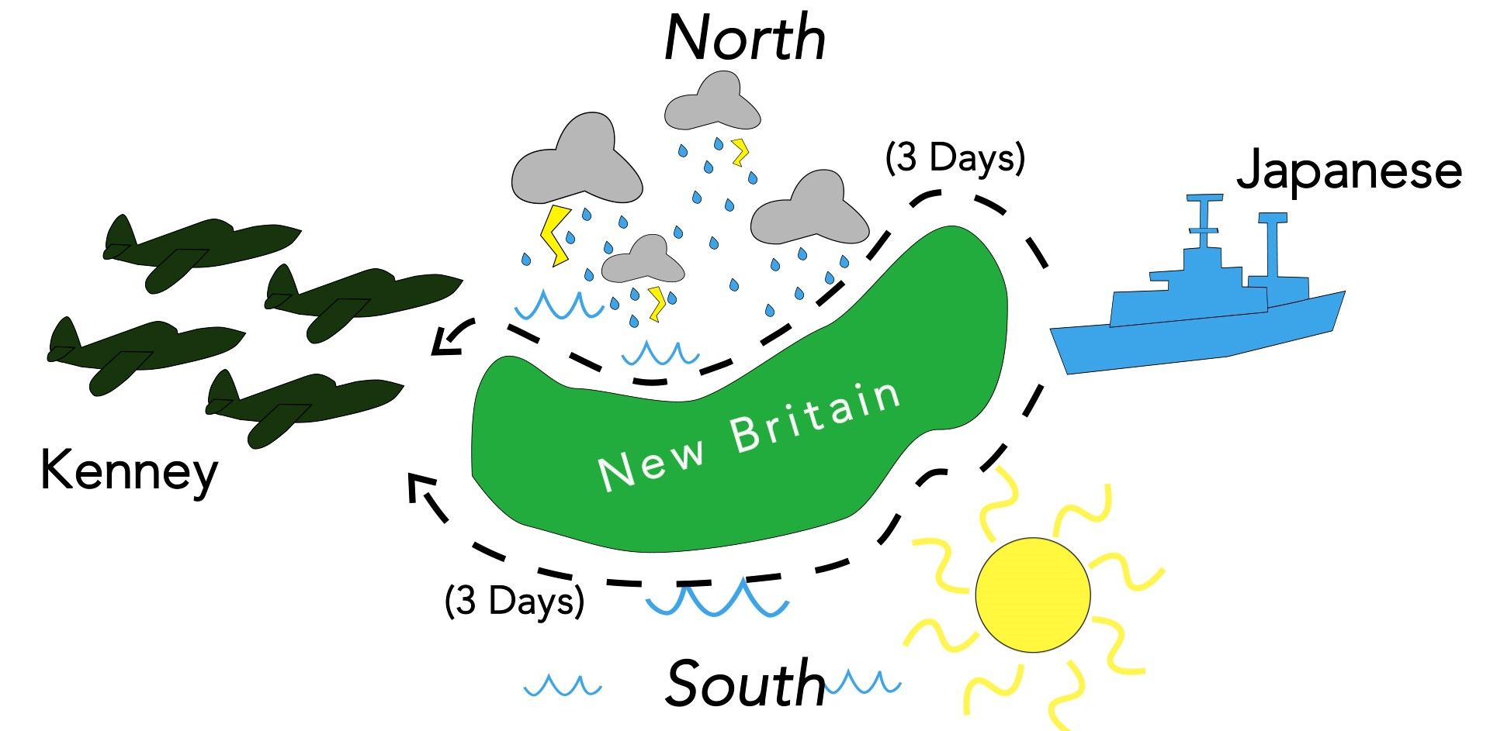
Exercise – The Battle of Bismarck Sea
Notes:
Slide notes:
See The Battle of Bismarck Sea Exercise.docx and The Battle of Bismarck Sea Exercise – Instructor Notes.docx

Slide 5
Game Theory in Cybersecurity?
Lesson 1 outlined the role of strategic reasoning in adversarial thinking.
In this lesson we will learn some game theory basics.
Cybersecurity academic literature contains many examples of game theory being applied to securing computer networks, computer systems, and even power grids.
Plus, learning basic game theory principles is a proven way to improve one’s strategic reasoning abilities.
Notes:
Slide objectives:
Segue from Lesson 1 to Lesson 2
Connect game theory to cybersecurity
Slide notes:
Here are some examples of game theory appearing in the cybersecurity literature:
X. Liang and Y. Xiao, "Game Theory for Network Security," in IEEE Communications Surveys & Tutorials, vol. 15, no. 1, pp. 472-486, First Quarter 2013.
C. A. Kamhoua, H. Zhao, M. Rodriguez and K. A. Kwiat, "A Game-Theoretic Approach for Testing for Hardware Trojans," in IEEE Transactions on Multi-Scale Computing Systems, vol. 2, no. 3, pp. 199-210, July-Sept. 1 2016.
S. Hamman, K. Hopkinson, and L. McCarty, “Applying Behavioral Game Theory to Cyber-Physical Systems Protection Planning,” in Cyber-Physical Systems: Foundations, Principles, and Applications, Elsevier, Academic Press, 2017.
There is even an entire subfield of game theory that deals with so-called security games:
Tambe, M. (2011). Security and Game Theory: Algorithms, Deployed Systems, Lessons Learned. Cambridge: Cambridge University Press.
Here are some example of game theory being used to improve strategic reasoning:
C. F. Camerer, Behavioral Game Theory. Princeton, NJ, USA: Princeton Univ. Press, 2003:
““Strategic thinking seems to be more like learning to windsurf, ski, or fly an airplane, activities that require people to learn skills which are unnatural but teachable, and less like weight-lifting or dunking a basketball, where performance is
constrained by physical limits.”
As it is empirically based, learning about the concept of level-k reasoning and how many levels deep people typically descend can prove especially beneficial for improving a person’s strategic thinking abilities. Camerer comments anecdotally that after only an hour of level-k reasoning training, research subjects off the street perform better than undergraduate game theory students in strategic contests.
A. M. Brandenburger and B. J. Nalebuff, Co-opetition. New York, NY, USA: Doubleday, 1996:
The bestselling book Co-opetition teaches basic game theory (no equations or graphs) in order to help business leaders make better strategic decisions.
R. J. H. Gash, “Game theory: Can a round of poker solve Afghanistan’s problems?” Small Wars J., vol. 5, no. 3, pp. 1–4, 2009, accessed on Dec. 16, 2016. [Online]. Available: http://smallwarsjournal.com/blog/journal/docs-temp/195-gash.pdf?q=mag/.../195-gash.pdf
A military researcher affirms that the same kind of approach is effective with military personnel. He writes, “Although one can quickly become bogged down with the mathematics of game theory, a rudimentary understanding of its basic principles can prove quite beneficial to military planners.”
MGT 525: Competitive Strategy, Yale Univ., New Haven, CT, USA, accessed on Mar. 15, 2016. [Online]. Available: http://faculty.som.yale.edu/FionaScottMorton/documents/syll_08.pdf
G570: Thinking Strategically: Game Theory and Business Strategy, Indiana Univ. at Bloomington, Bloomington, IN, USA, accessed on Mar. 15, 2016. [Online]. Available: http://kelley.iu.edu/BEPP/Masters/page14312.cfm?ID=9502
Some MBA programs also teach basic game theory to improve the strategic thinking abilities of the future business executives in their programs

Slide 6
Game Theory Background
Game theory is not primarily concerned with sports, board games, video games, etc. – although these activities may involve some elements of game theory.
The academic discipline of game theory aids in the rigorous analysis of market competition (i.e., economics), battlefield strategies, and even nuclear war deterrent policies!
Game theory was formally established as an academic discipline by the 1944 publication of Theory of Games and Economic Behavior by John von Neumann and Oskar Morgenstern.
John Nash went on to make major contributions to the field in the 1950s.
Notes:
Slide objectives:
Clear up any confusion about game theory’s relationship to the common conception of games.
Provide a brief history of game theory
Slide notes:
There are games of skill, games of chance, and games of strategy. Game theory deals with games of strategy.
Game theory originally was devised to deal with economic scenarios, and is still a staple of the discipline of economics today. It helps answer questions like:
How many widgets should we produce next year?
How much should we charge per widget?
For what demographics should we market our widget?
The answers to these questions involve strategy, because companies compete with one another to sell products. Each company has to decide what it is going to do without knowing what the other companies are going to do.
In the last few decades, game theory has also become an important subdiscipline in many other fields, including computer science, math, political science, law, biology, and international relations.
John von Neumann was a brilliant polymath and is also one of the fathers of computing and computer science. Today’s computers are based on the von Neumann architecture, which means they consist of a processing unit, a control unit, memory, storage, and input/output devices.
The 2001 Academy Awards Best Picture, A Beautiful Mind, was based on the life of John Nash, who was played by Russell Crowe in the film.

Slide 7
Game Theory Definition
Game theory is a mathematically rigorous approach to analyzing strategic contests (games of strategy, not games of skill or chance).
For the purposes of this class, it can be defined as: The study of interdependent decision making between multiple players where each player strives to maximize his own utility.
There are three primary ingredients to any game:
Players – the actors in the game
Interdependent choices – the final outcomes for each player are dependent upon all of the other players’ choices
Utility preferences – the order of the outcomes from least desirable to most desirable
Game theory is an entire semester class for economics majors – we are just going to cover the tip of the iceberg in this module!
Notes:
Slide objectives:
Define game theory for the purposes of this module and lesson.
Slide notes:
This introduction to game theory is necessarily abbreviated because the field of game theory is huge.
In this module we just cover some basic terminology and general principles.
In the discipline of game theory, there are many types of games that have been defined, including:
Two player and multi-player
Finite and infinite
Cooperative and non-cooperative
Perfect and imperfect information
Complete and incomplete information
Zero-sum and non-zero sum
Constant sum and positive sum
One shot and repeated play
Etc.
In this lesson we really only discuss 2 person, finite, non-cooperative, perfect, incomplete, constant sum, one shot games.

Slide 8

Game Theory Example…
Notes:
Slide objectives:
Provide an example of a famous game theoretical game – the Prisoner’s Dilemma recast as the Hacker’s Dilemma
Slide Notes:
This YouTube video was produced at Cedarville University in 2018 and carries a Creative Commons license
This is the direct link to the video:
https://youtu.be/bEld47ETG1k

Slide 9
The Hacker’s Dilemma
The Hacker’s Dilemma is a cyber-themed retelling of the Prisoner’s Dilemma – probably the most famous game in game theory.
The dilemma has been dramatically portrayed in literature, films, television shows, and British game shows have even been modeled after it!
What makes it fascinating is the unfortunate result (for the players at least!)
Why can’t both players just keep their mouths shut and end up with the better outcome?
Notes:
Slide objectives:
Providing background on the Hacker’s Dilemma
Nurture intrigue regarding the unfortunate outcome experienced by the players
Slide notes:
The Prisoner’s Dilemma Wikipedia page has lots of helpful information:
https://en.wikipedia.org/wiki/Prisoner%27s_dilemma
Shafted is the name of one British game show that employs the Prisoner’s Dilemma:
https://en.wikipedia.org/wiki/Shafted

Slide 10
The Hacker’s Dilemma - Recap
Q1: Who are the players in the hacker’s dilemma?
Q2: What are the interdependent choices available to the players?
Q3: What are the utility preferences (i.e., the ordering of the outcomes) for the players?
Notes:
Slide objectives:
Drive home the major game theory components that appeared in the video.
Slide notes:
These questions are intended to recap the Hacker’s Dilemma video.
Here are the correct answers…
A1:
Alice
Bob
A2:
Defect – rat one another out
Cooperate – keep their mouth’s shut
A3:
Their utility preferences were directly related to jail time. The less time in jail, the more preferable!
Follow-up Question:
Their utility preferences are probably overly simplistic – besides jail time, what else may have factored into their utility preferences?
Follow-up Answer:
Moral qualms – fear of some future punishment associated with lying to the police
Social disgrace – fear of being an outcast for betraying their partner
Fear of reprisal – wondering whether the partner (or close associates or family of his) might take revenge
The dynamics of the Prisoner’s Dilemmas have been recreated in the lab, and people often do not Defect. In a recent experiment conducted in an actual prison with prisoners, almost 60% of them chose
to Cooperate and only 40% chose to Defect. Of course one speculates that if the stakes would have been long prison terms instead of the award of cigarettes the outcomes may have been closer to those
predicted by game theory. See: M. Khadjavi, A. Lange, “Prisoners and their Dilemma,” Journal of Economic Behavior & Organization, vol. 92, no. 1, pp. 163-175, 2013.

Slide 11
Analysis – The Hacker’s Dilemma
 |  | Alice
 |  | C | D
Bob | C | 3, 3 | 1, 4
 | D | 4, 1 | 2, 2
Notes:
Slide objectives:
Explain how to interpret the normal form representation of a game
Slide notes:
This is the Hacker’s Dilemma represented in normal form. This normal form grid captures all of the essential ingredients of the game, and it makes it easier to analyze the game.
Each of the four squares represent combinations of choices. The top-left square is where Bob and Alice both choose to Cooperate. The other squares represent different combinations of Cooperate and Defect.
In each square, the numbers represent utility. The higher the number the better. Utility is like money – more money is always better than less money!
Since he is listed at the left, Bob is the row player, and since she is listed at the top, Alice is the column player. Each player’s possible choices are listed by their names – in this case, they each have the choices of Cooperate or Defect. In other games, their choices may be different from one another.
When a square has two numbers, the row player’s utility is listed first, and the column player’s utility is listed second. In some games, only one number is listed per square. This is a way of representing a zero-sum game, which means that one players gain is exactly the other player’s loss. In this case, the number is to be interpreted as the row player’s utility. The column player’s utility is the negative of the row player. So a 4 would mean 4 for the row player, and -4 for the column player. We will see an example of this later.
Q1:
What combination of choices does the bottom left square represent?
A1:
Bob – Defect, Alice – Cooperate
Q2:
What is Bob’s utility for this outcome? What is Alice’s utility?
A2:
Bob – 4, Alice – 1
Q3:
Are their any other outcomes that Bob prefers more than this one? How about Alice?
A3:
Bob – no. 4 is the highest row number in the grid, meaning this is Bob’s top outcome. Recall that Bob likes this outcome because it means he doesn’t have to go to prison.
Alice – yes. 1 is the lowest column number in the grid, meaning this is Alice’s least preferable outcome. Recall that this outcome means that Alice has to spend 10 years in prison – the highest possible prison term.

Slide 12
Analysis – The Hacker’s Dilemma
 |  | Alice
 |  | C | D
Bob | C | 3, 3 | 1, 4
 | D | 4, 1 | 2, 2
Notes:
Slide objectives:
Examine why the hackers do not end up in the better outcome of Cooperate - Cooperate
Slide notes:
It would seem natural for the players to end up with the Cooperate – Cooperate outcome:
This is what they agreed to do ahead of time
It is the best by far of the two “fair” outcomes – they both get their second to highest choice

Slide 13
Analysis – The Hacker’s Dilemma (cont’d)
 |  | Alice
 |  | C | D
Bob | C | 3, 3 | 1, 4
 | D | 4, 1 | 2, 2
Notes:
Slide objectives:
Examine why the hackers do not end up in the better outcome of Cooperate - Cooperate
Slide notes:
However, from both players’ perspectives, if they think they might land at Cooperate – Cooperate, there is an incentive to Defect! After all, no prison time (represented by utility 4) is much preferable to an entire year in prison.
Therefore, they are both being pulled toward Defect like a magnet.
Ultimately, this results in them ended up with the inferior Defect – Defect outcome.
The bottom line: Cooperate – Cooperate is an unstable position that it is difficult to hold, especially if one player has even the slightest suspicion that the other player might rat him out.

Slide 14
Analysis – The Hacker’s Dilemma (cont’d)
 |  | Alice
 |  | C | D
Bob | C | 3, 3 | 1, 4
 | D | 4, 1 | 2, 2
Notes:
Slide objectives:
Examine why the hackers do not end up in the better outcome of Cooperate – Cooperate
Introduce the concept of the Nash Equilibrium
Slide notes:
Defect – Defect is the only stable outcome in this game.
From this point, neither player can unilaterally change his or her choice and end up with a better outcome. For example, if either Bob or Alice were to change to Cooperate while the other remained at Defect, the one who changed would receive 10 years in prison rather than 5 – a worse outcome.
This equilibrium dynamic is called the Nash Equilibrium because it was identified by John Nash. In this game, there is only 1 Nash Equilibrium because in any other of the 3 squares, at least one of the players could unilaterally deviate from his or her choice and end up with a better outcome.

Slide 15
The Prisoner’s Dilemma IRL
The Prisoner’s Dilemma is also famous because it applies to just more than just interrogation rooms! It applies in real life (IRL), too!
Doping in sports is a real-life prisoner’s dilemma situation…
From an interview with former Major League Baseball player Lenny Dykstra:
Interviewer: Did you ever use HGH? [a performance enhancing drug]
Dykstra: I put that in my cereal man. It was in my cereal. C’mon HGH? Nah, we’re talking about the good stuff, y’know? Deca Durabolin and Testosterone and Anadrol [steroids]. We're talking about the difference of making $30 million or getting a real job and working and making $60,000. What? Do you want the guy next to you taking them and you're not going to take them?
Notes:
Slide objectives:
Bring the Prisoner’s Dilemma into the realm of real life to show that game theory is practical.
Slide notes:
If no athletes dope (the Cooperate – Cooperate outcome), everybody would be better off because they wouldn’t have to deal with the dire health consequences of taking performance enhancing drugs, and all of the athletes would still be competing on a level playing field where the best athletes would still be the best athletes. A true meritocracy. But this leaves the door open for cheaters (Defectors) to gain an upper-hand and outperform the other athletes! In sports, not doping, is an unstable outcome just like Cooperating in the Prisoner’s Dilemma – it is really difficult to remain there.
Lenny Dykstra is a famous professional baseball player who has led a tumultuous life:
https://en.wikipedia.org/wiki/Lenny_Dykstra
“The doping arms race will continue because of the incentives. It's a classic prisoner's dilemma. Consider two competing athletes: Alice and Bob. Both Alice and Bob have to individually decide if they are going to take drugs or not.
Imagine Alice evaluating her two options:
'If Bob doesn't take any drugs,' she thinks, 'then it will be in my best interest to take them. They will give me a performance edge against Bob. I have a better chance of winning.
'Similarly, if Bob takes drugs, it's also in my interest to agree to take them. At least that way Bob won't have an advantage over me.
'So even though I have no control over what Bob chooses to do, taking drugs gives me the better outcome, regardless of his action.’
Unfortunately, Bob goes through exactly the same analysis. As a result, they both take performance-enhancing drugs and neither has the advantage over the other. If they could just trust each other, they could refrain from taking the drugs and maintain the same non-advantage status -- without any legal or physical danger. But competing athletes can't trust each other, and everyone feels he has to dope -- and continues to search out newer and more undetectable drugs -- in order to compete. And the arms race continues.”
From Bruce Schneier:
https://www.schneier.com/essays/archives/2006/08/drugs_sports_prisone.html

Slide 16
Real Life Through the Lens of Game Theory
With the Prisoner’s Dilemma, we started with a game and then saw how it applied to real life.
But the point of game theory is that it can help with the analysis of real-life situations.
In this next exercise, we begin with a real-life situation that on the surface appears like it has nothing to do with security, game theory, or even strategy.
But we can analyze it in terms of players, interdependent choices, and outcome preferences to try and predict how the situation will turn out.
Because it is real-life, it is going to be a little messy, but that is ok! We will acknowledge simplifying assumptions when they are needed.
Notes:
Slide objectives:
Show that real life situations can be viewed through the lens of game theory and can help predict what will happen.
Slide notes:
This slide sets up the motivation behind the Solomon’s Wise Ruling exercise.
The following story may or may not be familiar to many students, depending on the context.

Slide 17
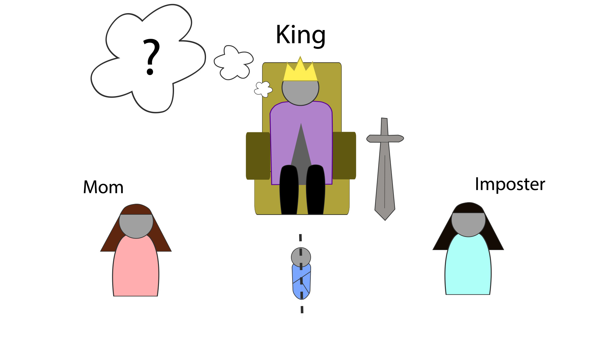
Exercise – Solomon’s Wise Ruling
Notes:
Slide notes:
See Solomons Wise Ruling Exercise.docx and Solomons Wise Ruling Exercise – Instructor Notes.docx

Slide 18
Solomon’s Wise Ruling - Recap
Solomon’s Wise Ruling has a happy ending for the real mother [Mom], in that she received her baby back – but she couldn’t have known this ahead of time from her perspective!
Game theory predicted the outcome because both Mom and Imposter behaved rationally – this is not always the case in games.
The analysis of the game proceeded iteratively because a strictly dominated strategy was identified – under no circumstances would Imposter choose Reject, which enabled Mom to identify her strategy.
Notes:
Slide objectives:
Wrap-up loose ends with the exercise
Reinforce the concept of strictly dominated strategies
Slide notes:
At first, when Mom considered what Imposter might do, it provided no help in deciding between Accept and Reject. (This did not happen with the hacker’s dilemma.) But then, when the game was analyzed from Imposter’s perspective, it became clear that Imposter would never choose Reject, which means that Reject is a strictly dominated strategy for Imposter. Now, Mom can safely rule this out from consideration, helping her to see that her only appropriate choice was to Reject.

Slide 19
Analyzing Games – Start with Other Player
In both the Hacker’s Dilemma and in Solomon’s Wise Ruling, the game was analyzed by viewing the situation through the choices available to the other player.
Bob figured out what he would do if Alice Cooperated, and he figured out what he would do if Alice Defected.
Mom figured out what she would do if Imposter Accepted, and she figured out what she would do if Imposter Rejected.
This type of analysis, called best response analysis, is very important for strategic thinking – it is putting yourself in the shoes of your adversary to help you determine what you should do.
Notes:
Slide objectives:
Drive hope the importance of considering the other players’ perspectives and choices
Slide notes:
The most important take-away for us is to see that when analyzing a strategic scenario, you must put yourself in the other player’s shoes and consider the world from their perspective. You also must take the time to enumerate their choices and you must consider their utility preferences.
There are more mathematical ways to analyze games which are sometimes necessary because in some games, only mixed strategy equilibria exists, which is where the players make their choices based on a probability distribution. This means that with a certain percentage chance they do A or B.
In both of the games we have looked at there was a pure strategy solution, and they were amenable to our analysis of eliminating dominated strategies.
To conclude this lesson, let’s revisit the Battle of Bismarck Sea to try and figure out what General Kenney should do…

Slide 20
Analysis – The Battle of Bismarck Sea
Q1: Who are the players in the Battle of Bismarck Sea?
Q2: What are the interdependent choices available to the players?
Q3: What are the utility preferences (i.e., the ordering of the outcomes) for the players?
Notes:
Slide objectives:
Practice doing a game theoretical analysis.
Slide notes:
Recall the story again:
----------------------------------------------
“In February 1943, during the critical phase of the struggle in the south-western Pacific, the Allies received intelligence reports indicating that the Japanese were planning a troop and supply convoy to reinforce their army in New Guinea. The convoy could sail either north of the island of New Britain where rain and poor visibility were almost certain, or south of the island, where the weather would probably be fair. By either route, the trip would take three days. General George C. Kenney, commander of Allied forces in the South Pacific, was ordered by his supreme commander, General MacArthur, to attack the convoy with the objective of inflicting maximum destruction. General Kenney had to decide whether to concentrate the bulk of his reconnaissance aircraft on the northern or the southern route. Once the convoy was sighted, it would be bombed continuously until its arrival in New Guinea.
“Kenney’s staff estimated that if the reconnaissance aircraft were concentrated mainly on the northern route, then the convoy would probably be sighted after one day, whether it sailed north or south, and would therefore be subjected to two days of bombing in either case. If the aircraft were concentrated mainly on the southern route, on the other hand, then either one or three days of bombing would result depending on whether the Japanese sailed north or south, respectively. The number of days of bombing may be interpreted as Kenney’s gains and the Japanese commander’s losses.”
----------------------------------------------
These questions are intended to be used to gauge understanding.
Here are the answers to the questions posed to students…
A1:
General Kenney
Japanese Commander
A2:
General Kenney – Recon N or Recon S
Japanese Commander – Sail N or Sail S
A3:
These are tied directly to the number of days of bombing
In fact, this is a zero sum game.
From Kenney’s perspective, the more days the better and from the Japanese perspective, the less days the better.
Follow-up Exercise:
Have the students, either individually, or in small groups, create the normal form game grid.
Go to next slide after the students have done this…

Slide 21
Analysis – The Battle of Bismarck Sea (cont’d)
 |  | Japanese
 |  | N | S
Kenney | N | 2 | 2
 | S | 1 | 3
Notes:
Slide objectives:
Practice doing a game theoretical analysis.
Slide notes:
This is what the grid looks like. The number in each square represents the number of days of bombing. So, the combination of Kenney N, Japanese S, represents 2 days of bombing. This has utility preference 2 for Kenney and -2 for the Japanese. We only need one number because this is a zero-sum game. Kenney’s gain is exactly the Japanese’s loss.
Follow-up Exercise:
Have the students, either individually, or in small groups, analyze the game to determine the Nash Equilibrium.
Go to next slide after the students have done this…

Slide 22
Analysis – The Battle of Bismarck Sea (cont’d)
 |  | Japanese
 |  | N | S
Kenney | N | 2 | 2
 | S | 1 | 3
Notes:
Slide objectives:
Practice doing a game theoretical analysis.
Slide notes:
Kenney should perform Recon North, which guarantees 2 days of bombing. The Japanese should Sail North, which results in 2 days of bombing. The expected value of this game, therefore, is 2 days of bombing. This means that the Japanese are at a disadvantage in this game – they can’t win, the odds are stacked against them in Kenney’s favor. The best they can hope to do is minimize the maximum damage, which is called their minimax strategy. Meanwhile, Kenney pursues the strategy that maximizes the minimum damage, which is the maximin strategy. The analysis that we performed arrived at these strategies for both players.
And since this is a true story, we can learn what actually happened! Game theory predicts it correctly – Kenney placed the bulk of his recon to the north, and the Japanese sailed to the north.
[Note, there is also a mixed strategy Nash Equilibrium in this game where the Japanese sail N or S with equal probability (i.e., with a 50% chance for each). This is because the strategy of Recon N is only weakly dominated – the Japanese can switch to S unilaterally and receive the same utility (i.e., -2).]

Slide 23
Conclusion
Game theory is the study of interdependent decision making between multiple players where each player strives to maximize his own utility.
Real life strategic situations can be analyzed through the lens of game theory by identifying the players, the interdependent choices available to the players, and the utility preferences of the players.
Game theoretical analysis proceeds by viewing the situation through the choices available to the other player.
In the next lesson we will dig deeper into what it looks like to explore strategic situations from our adversary’s perspective by learning about Behavioral Game Theory.
Notes:
Slide objectives:
Providing a summary of the most important points of the lesson
Providing a segue to the next lesson.
Slide notes:
Wrapping up the second lesson by reinforces the most important points while providing a segue to the next lesson.

